Slide 1
Competitive Programming
29 Sep. 2023
Andrei Novikov

Slide 2
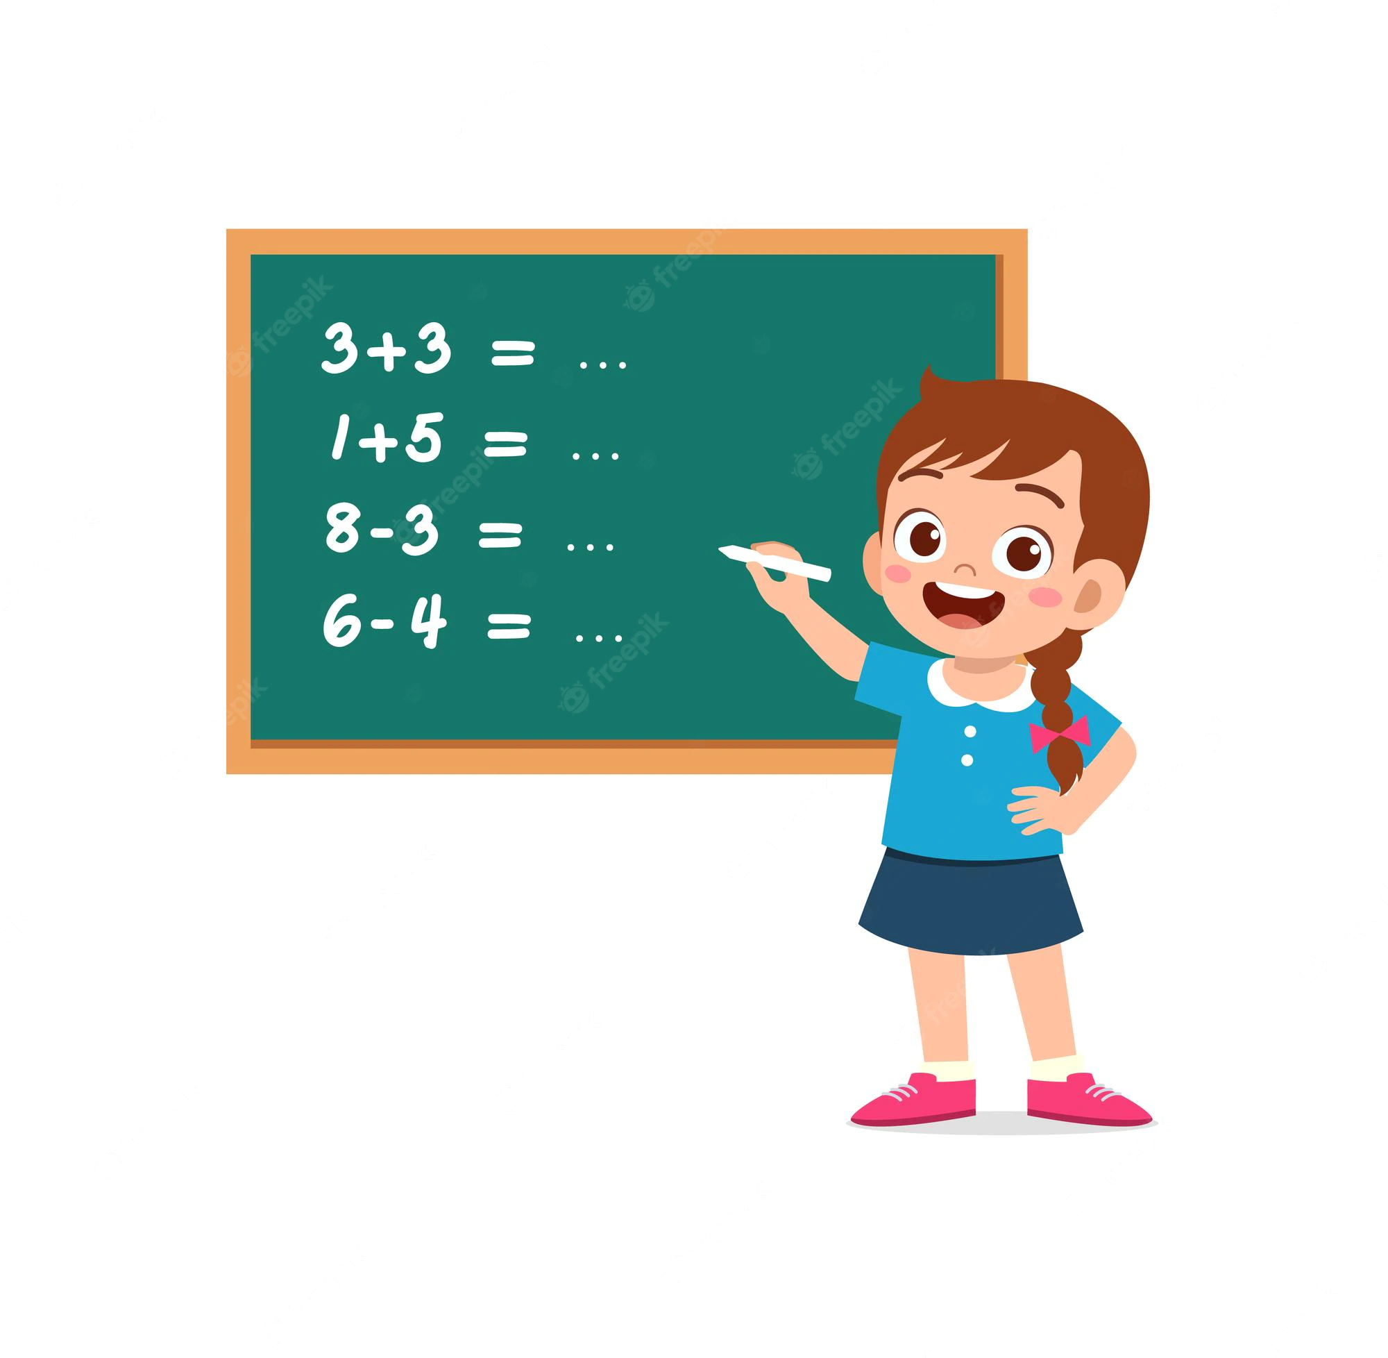
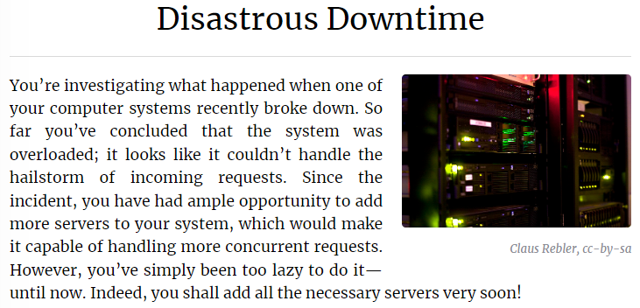
Practice – Binary Indexed Tree
Solve the problem:
Kattis. Disastrous Downtime – Link

Slide 3
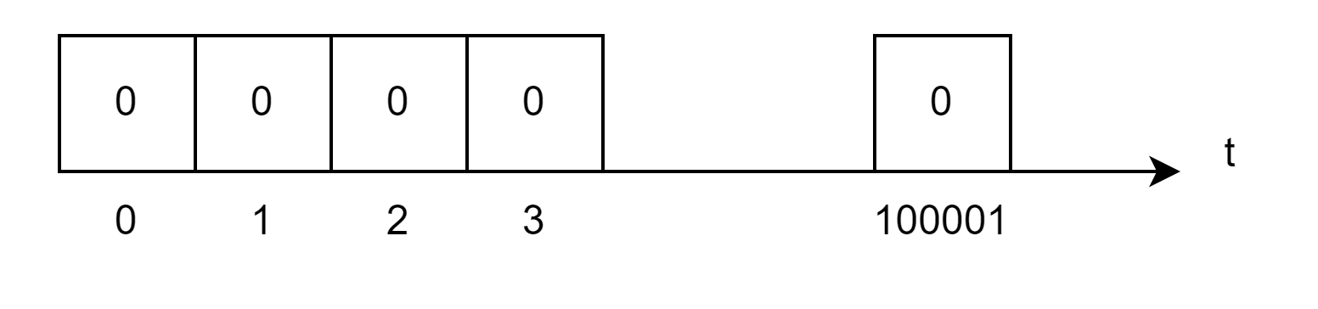
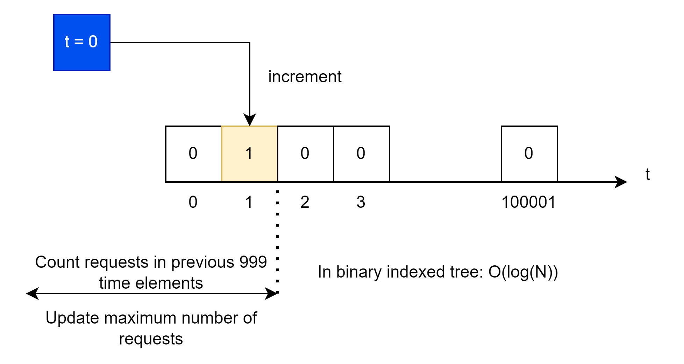
Practice – Binary Indexed Tree - Approach
Kattis. Disastrous Downtime – Link
Fenwick tree elements are timepoints, where each element contains the number of requests
When we need to add new request:
Add request i at time t_i.
Count sum between (i - 1000, i).
Update maximum number of requests (pike).

Slide 4
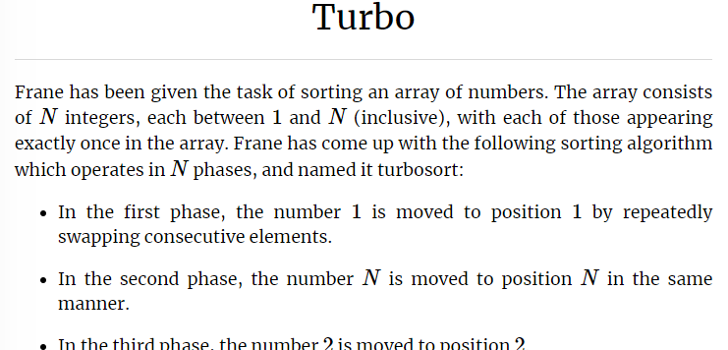
Practice – Binary Indexed Tree
Solve the problem:
Kattis. Turbo – Link

Slide 5
Practice – Binary Indexed Tree – Approach
Kattis. Turbo – Link
Topic: Fenwick Tree (Binary Indexed Tree)
Tips and Hints
Reserve memory in the front of the tree and at the back of the tree.
Place initial array in the middle of tree.
Move elements to beginning of the tree or to the end.
Count elements from current element position to its new place (log(N)).

Slide 6
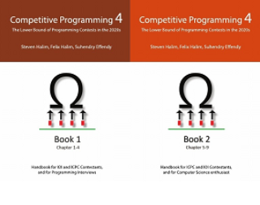
How to Learn and Practice
As one of the recommendation is to use:
Book Competitive Programming 4
Kattis – Link
Online Judge – Link
LeetCode - Link
Few Theory
A Lot of Practice
A Lot of Theory
Almost No Practice

